Slide 1



SAMM User Day
June 16th, 2020

Slide 2

Presenting
Lucian Corlan @securitystack
Currently @Sage - AppSec Head
Used to be a BIG4 consultant
Used to be the OWASP Cluj-Napoca Romania CL
Doing Security since 2006, hacking since 1999
Supporting the OWASP London UK Chapter
Check my security weekly @
www.securitystack.co

Slide 3
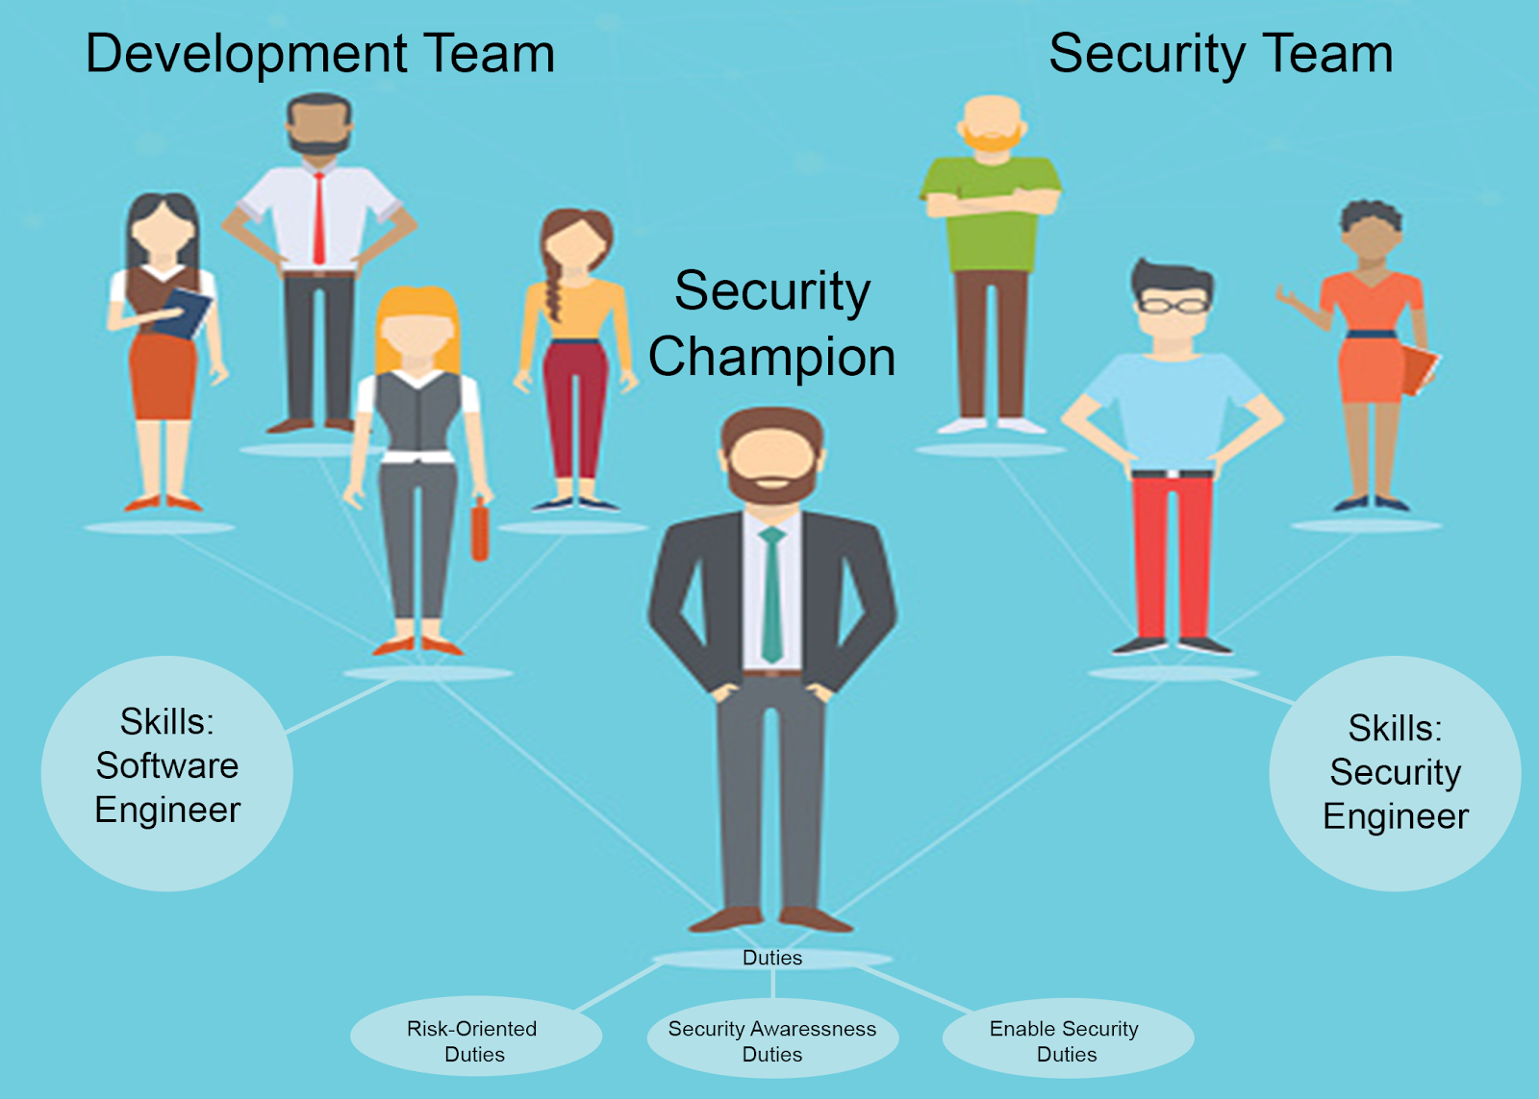
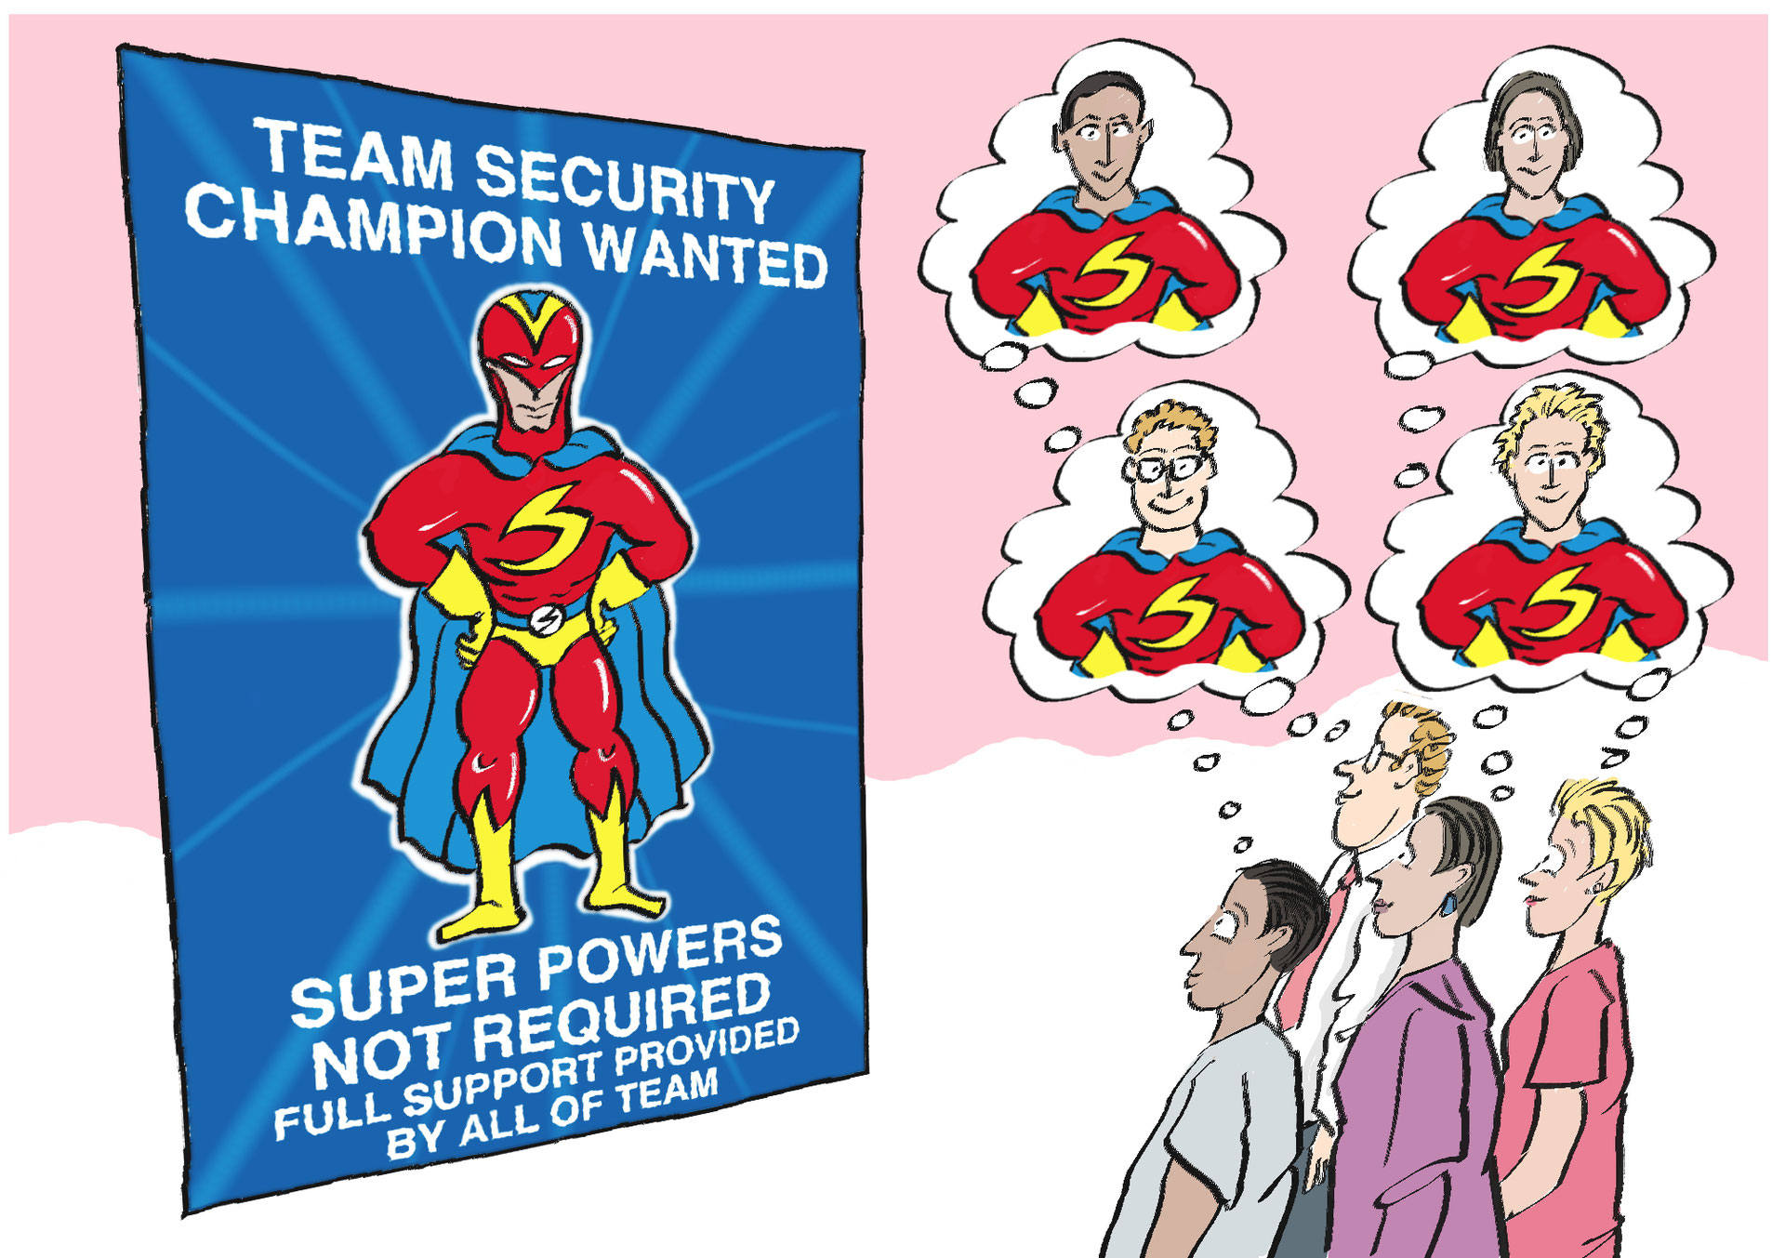
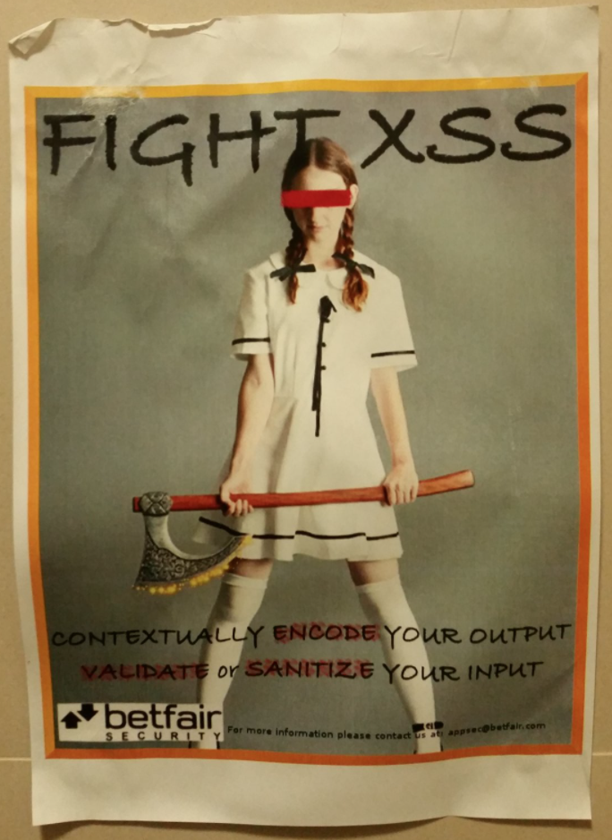


Security Champions

Slide 4
Currently recommended by
–OWASP Security Champions Playbook HERE Survey HERE
–OWASP SAMM v2 (yay!) HERE
–BSIMM v10 HERE
–SAFECode guide (2019) HERE
–NIST Special Publication 800-53 (Rev. 4) HERE
–SANS HERE
–Mozilla HERE
–Veracode HERE, Checkmarx HERE and others […?]
Previous OWASP presentation on Champions HERE

Slide 5
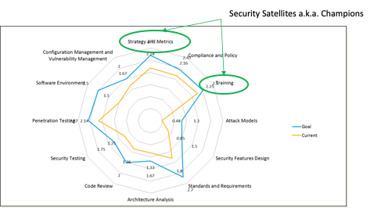
Why Security Champions?
AppSec Initiative Maturity
Application Security maturity is assessed as part of a drive to increase development teams’ awareness and use of security within the SDLC.
In this respect, OWASP SAMM and BSIMM are used for continuous Application Security Initiative Maturity (continuous) improvement.
The Security Champions are a key element of the model.

Slide 6
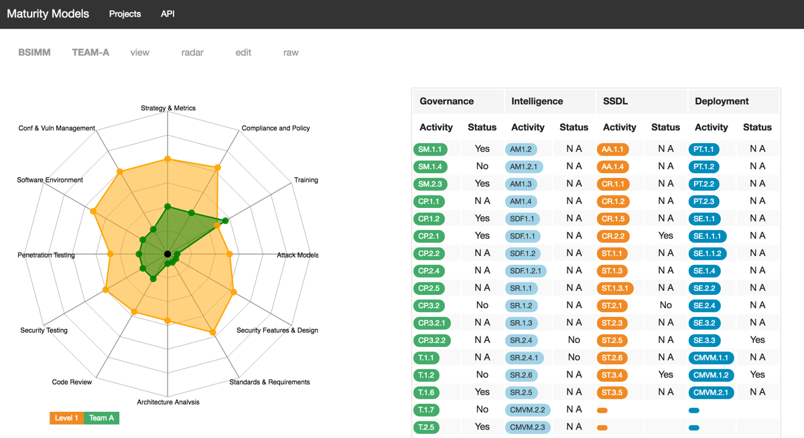
OWASP SAMM & Champions
ML1: Have you identified a Security Champion for each dev team?
  Security Champions receive appropriate training.
  Is training customized for individual roles such as developers, testers, or security champions?
  You train your architects, security champions, and other stakeholders on how to do practical threat modeling.
  Application Security and Dev teams receive periodic briefings from Security Champions on the overall status of security initiatives and fixes.
  The Security Champion reviews the results of external testing before adding to the application backlog.
ML2: Product Champions are responsible for promoting the use of specific security tools.
ML3: Develop a platform to help identify future members of the Secure Software Center of Excellence, or ‘Security Champions’ based on their expertise and willingness to help others.
Source: OWASP SAMM 2 and OWASP Maturity Models HERE
Check out Satish’s https://owaspsamm.org/user-day/samm-dashboard/

Slide 7
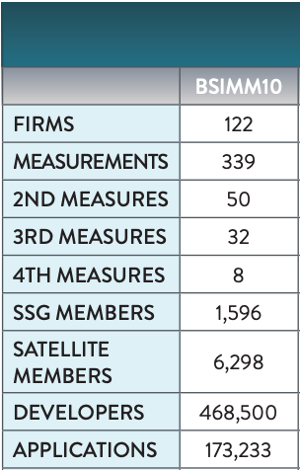
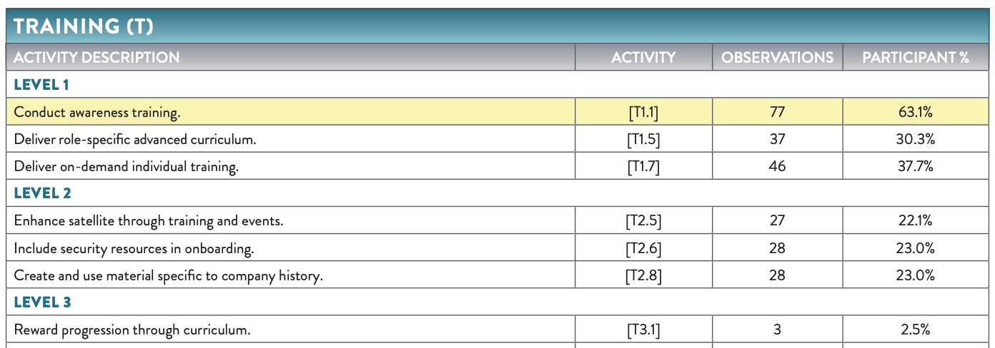
How many are there? And more...
Source: BSIMM 10

Slide 8
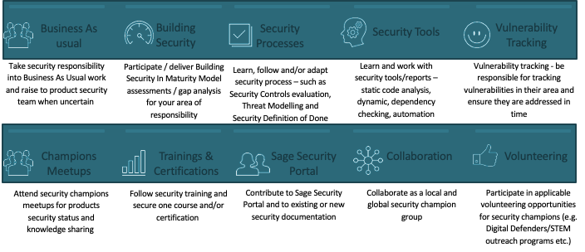
What do Champions do?

Slide 9
How to recognise? How to reward?
Reward progression through curriculum.
Knowledge is its own reward, but progression through the security curriculum brings other benefits, too, such as career advancement. The reward system can be formal and lead to a certification or an official mark in the human resources system, or it can be less formal and include motivators such as documented praise at annual review time. Involving a corporate training department and/or HR team can make security’s impact on career progression more obvious, but the SSG should continue to monitor security knowledge in the firm and not cede complete control or oversight. Coffee mugs and t-shirts can build morale, but it might take the possibility of real career progression to change behavior.
Source: BSIMM 10

Slide 11
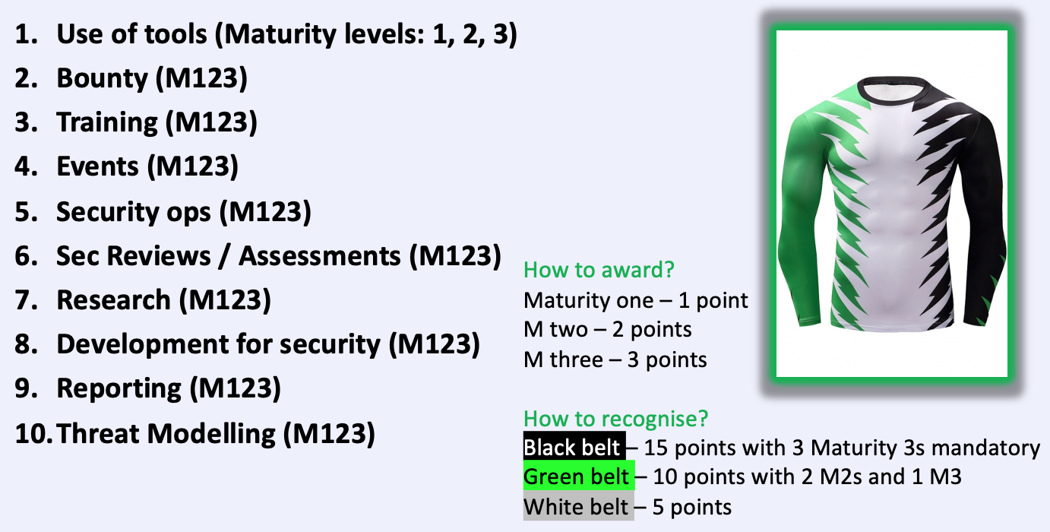
How to recognise? How to reward? revisited...

Slide 12
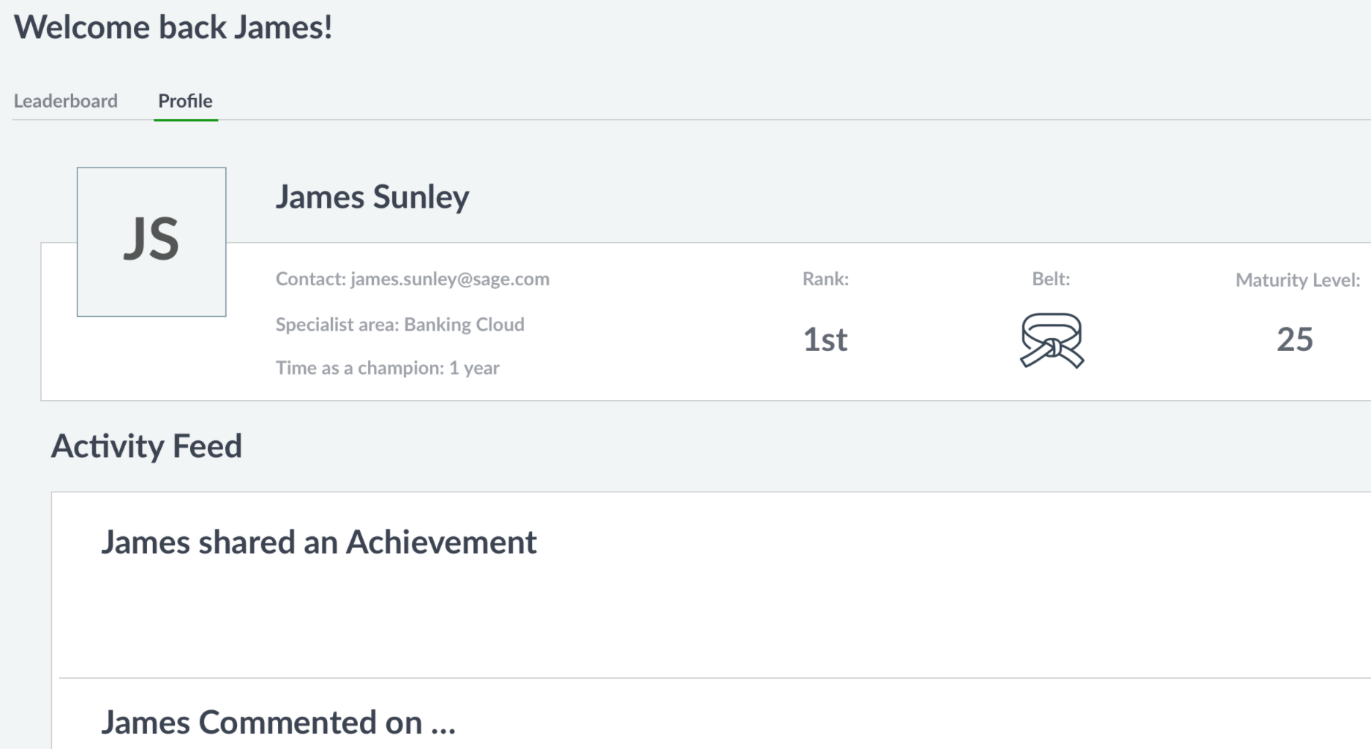
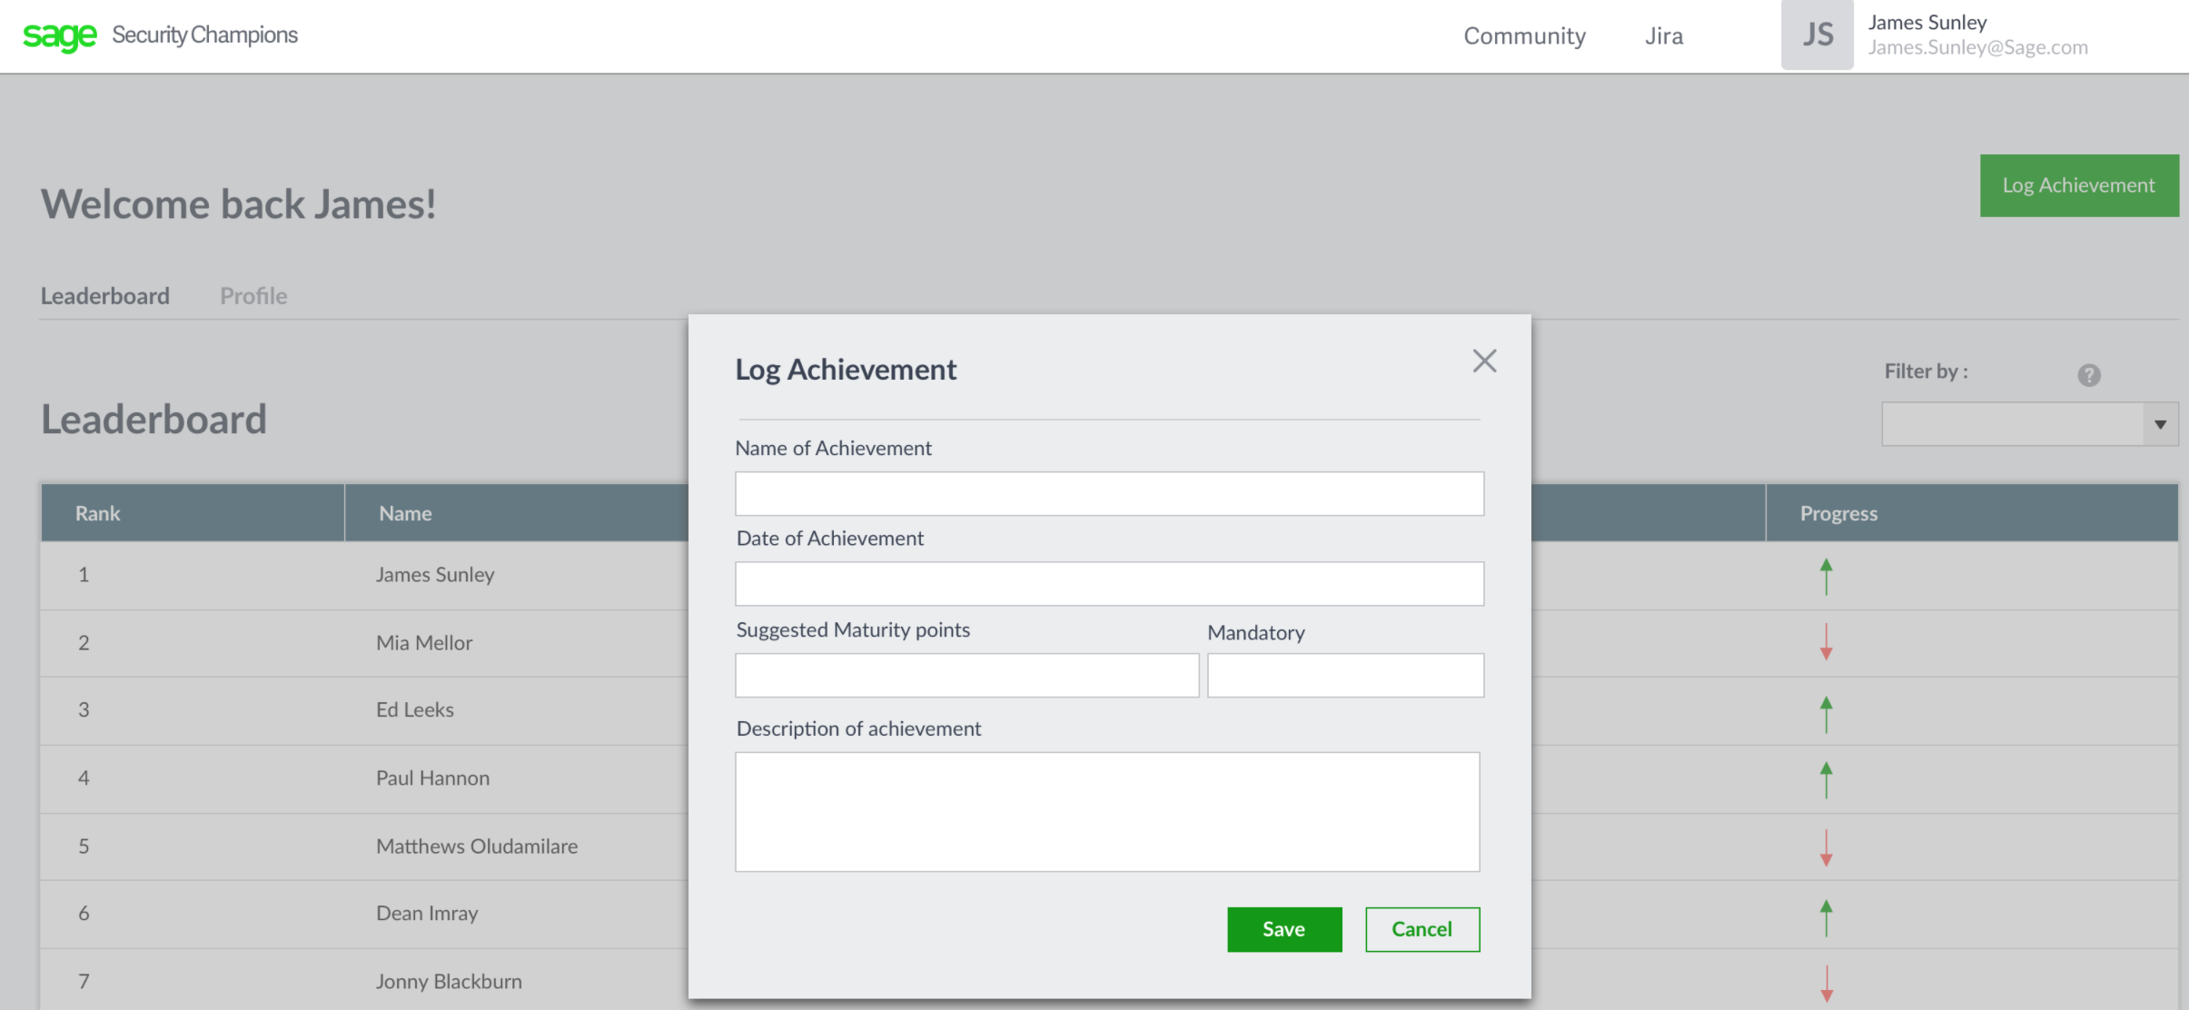
SC App
Open Sourced soon!
Excel version HERE
GitHub HERE
This presentation HERE

Slide 13
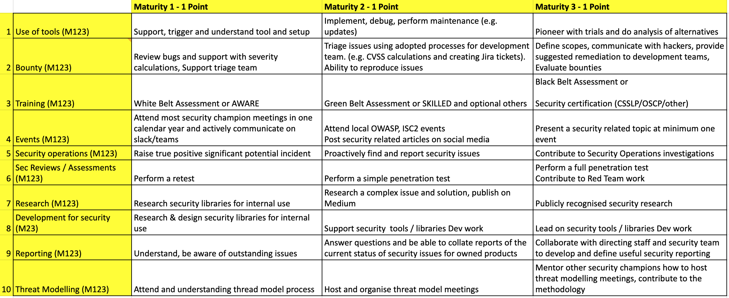
Detail...

Slide 14
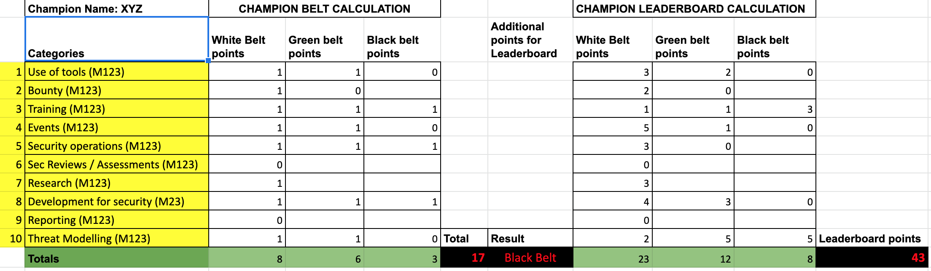
Detail...

Slide 15
Why do this? Support SCs...
In better understanding how to contribute to different areas of Security
Diversify their security knowledge and experience – maturity as a Security Champion
Into getting recognised and rewarded for their work and ideas
Keep track of progress and prove through example
To complete skills tournaments and assessments that the sec team organise
Demonstrate their skills through different competitions and assessments
Fulfil their objectives towards security contributing with ??% of their time
Measure the efficiency of the team security training and activities by comparing team maturity points with software vulnerability stats
Grow and build a capability able to run security alone
Develop a career in Security by joining the sec team

Slide 16
