Slide 1
Open control frameworks in Media and Entertainment
Ben Schofield - CDSA
June 17th 2020

Slide 2
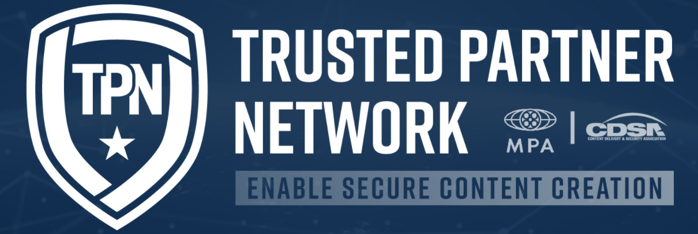
TPN aims
Improved content security in studio supply chain
Common control set
Efficient operations
Shared audit reports for studios
Reduced costs for vendors
Global talent pool for auditors
New challenges
Audience and revenues moving online
Consolidation of digital production and distribution
Rapid shift to cloud-based workflows
New skills and security culture required

Slide 3
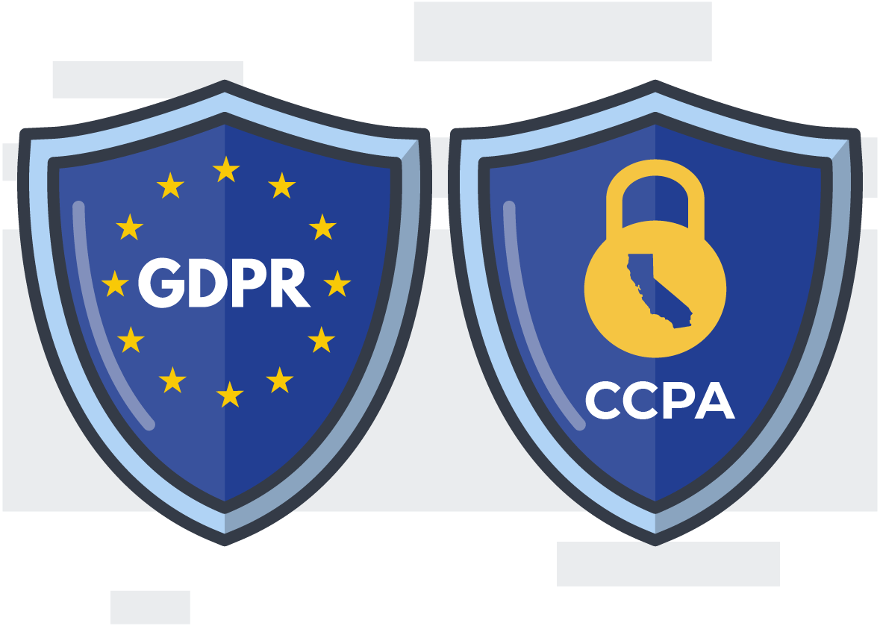
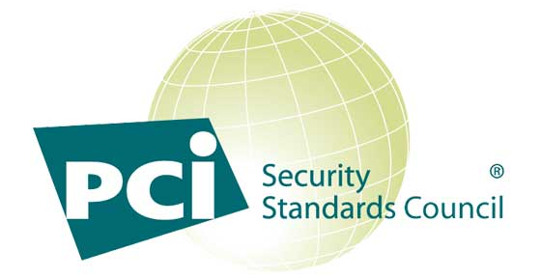
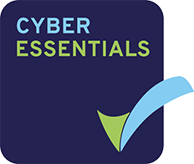
Content security
Evolution
US Studios
UK Broadcasters, Production, Vendors
Zero Trust
Awareness
Hygiene
Common controls
Professional audit
Shared data across members
Checklist
Self certified
Oversight
Regulated
Legislation
Penalties
Guidance
Controlled

Slide 4
Security audit
People & process
Physical
Facility
Asset management
Transport
Digital
Infrastructure
Content management
Content transfer
Cloud
Software release
Content
in/out
Content
in/out
DMZ
DMZ
Content
Production
Content
Production
Content
Production
Network
Content
Production
Network
People
& Process
Perimeter
Perimeter
Firewall
Firewall
Security
Security
Switch
Switch
System
System
System
System
Camera/key
Camera/key
Logging
Logging
Reception
Reception
Guest Wifi
& Mobile
Office
Office
Office
Network

Slide 5
App & cloud..
& integration
Code
Staff
Partners
Application
Cloud platform
Application
Application
Application
Application
Application
Configuration
Integration

Slide 6
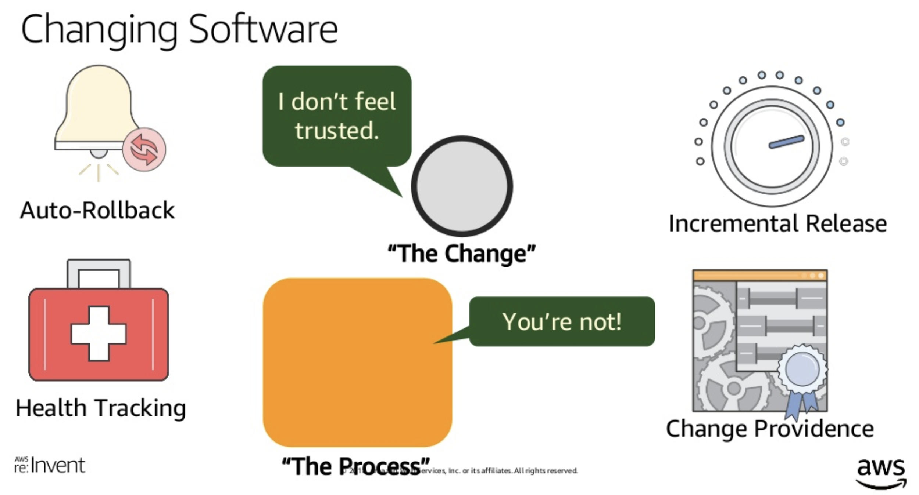
Complex software
Releasing Mission-Critical Software at Amazon (DEV209-R1) - AWS re:Invent 2018
Amazon
Netflix
Google
https://www.slideshare.net/AmazonWebServices/releasing-missioncritical-software-at-amazon-dev209r1-aws-reinvent-2018

Slide 7
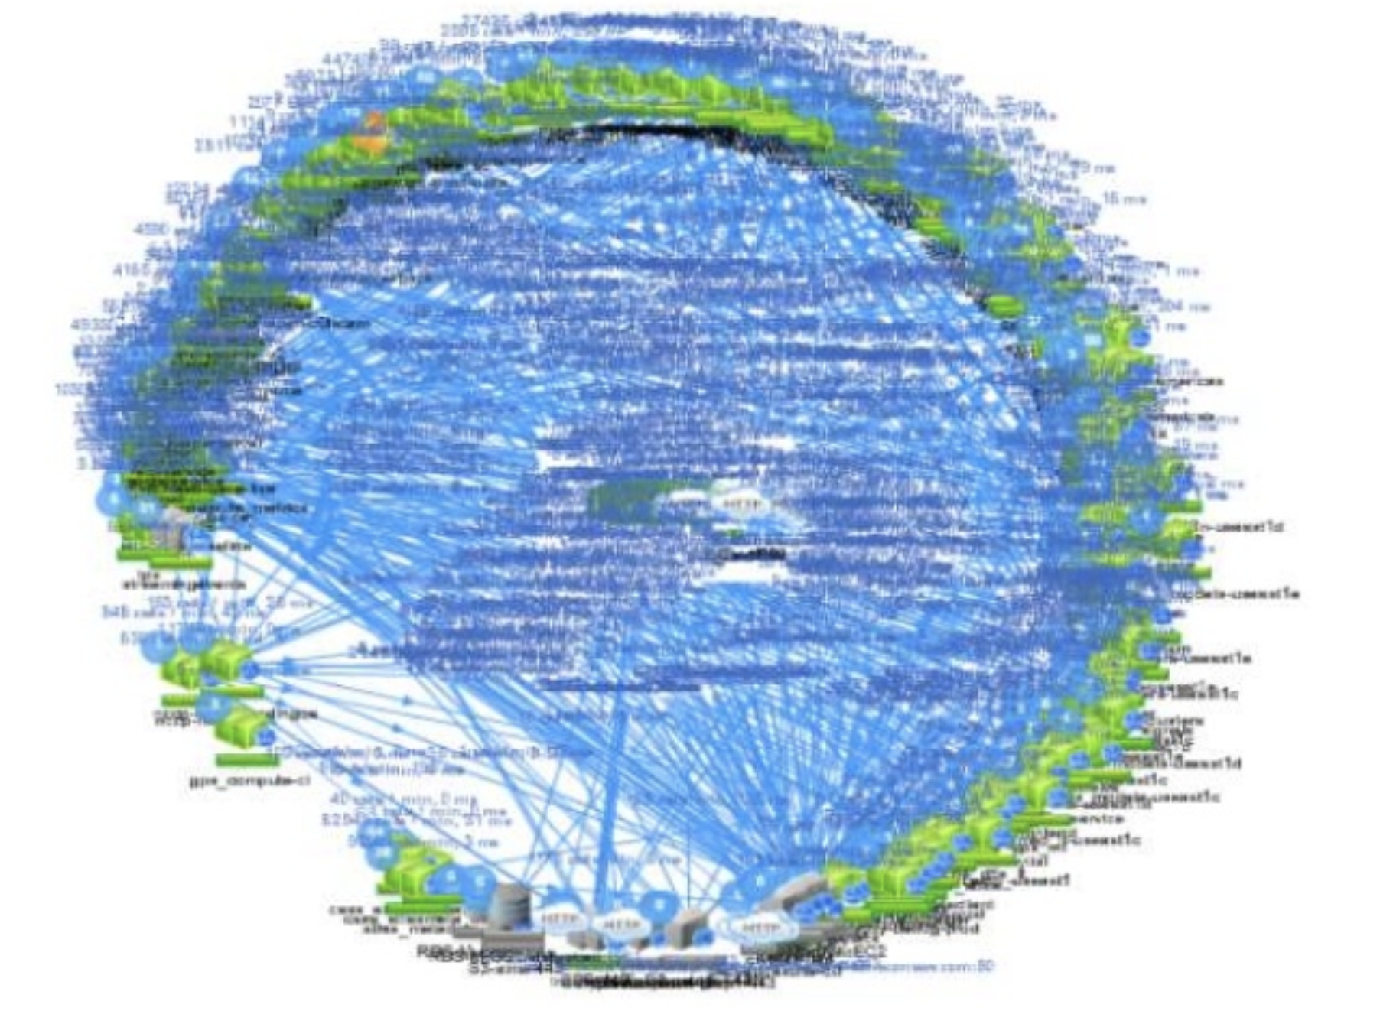
Complex software
Amazon
Netflix
Google

Slide 8
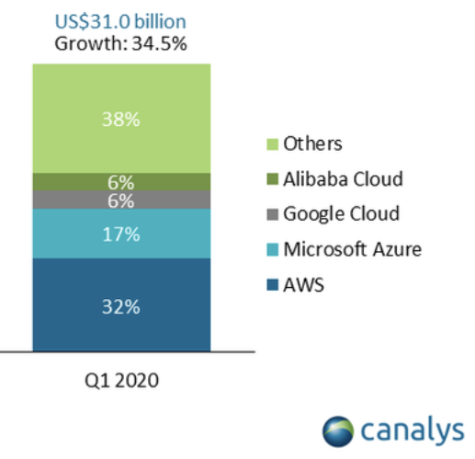
Shift to cloud
It’s all about software
New economics - CAPEX to OPEX
Move the tools and skills to the work
Frequency of audit
CDSA App & Cloud initiative launched to extend original programme to cover new use cases with a custom control set

Slide 9
Supply chain assurance
Range of business sizes & types
Effective security requires ongoing skills development
Consistent approach depends on the weakest link in the chain
Need to establish a security culture from CEO down

Slide 10
New approach
Map controls from industry standards, with frequent updates
Leverage cloud platforms best practice and design patterns
Deliver documentation in a usable format that is easily applied to any size of business
Automate tracking and checks to reduce the cost of audit
Help develop new skills to build a security culture
Business policy | Standards | Controls | Procedures | Metrics
Media supply chain | MPA CSA CCM CIS OWASP | Reduce initial control set to a target 150 Move detail into implementation guides | Use cases: Studio Post facility Cloud software System integrator Cloud vendor Platform | Audit

Slide 11
Progress
Bottom up mapping
Top down - reduced set mapped to key roles with basic narrative to enable vendors to start work
Engage with standards groups to confirm mapping and automate updates (YAML)
Engage with major cloud platforms to consolidate secure configuration guidelines and tooling
Reduce duplication with selected control equivalence, move detailed controls into implementation guides
Publish model documentation set to accelerate effective adoption in supply chain
Align threat model with ME-ISAC to automate risk register refresh
Confirm best practice training and skills development to establish new security culture
Automate continuous assessment and remote checks to reduce audit costs

Slide 12
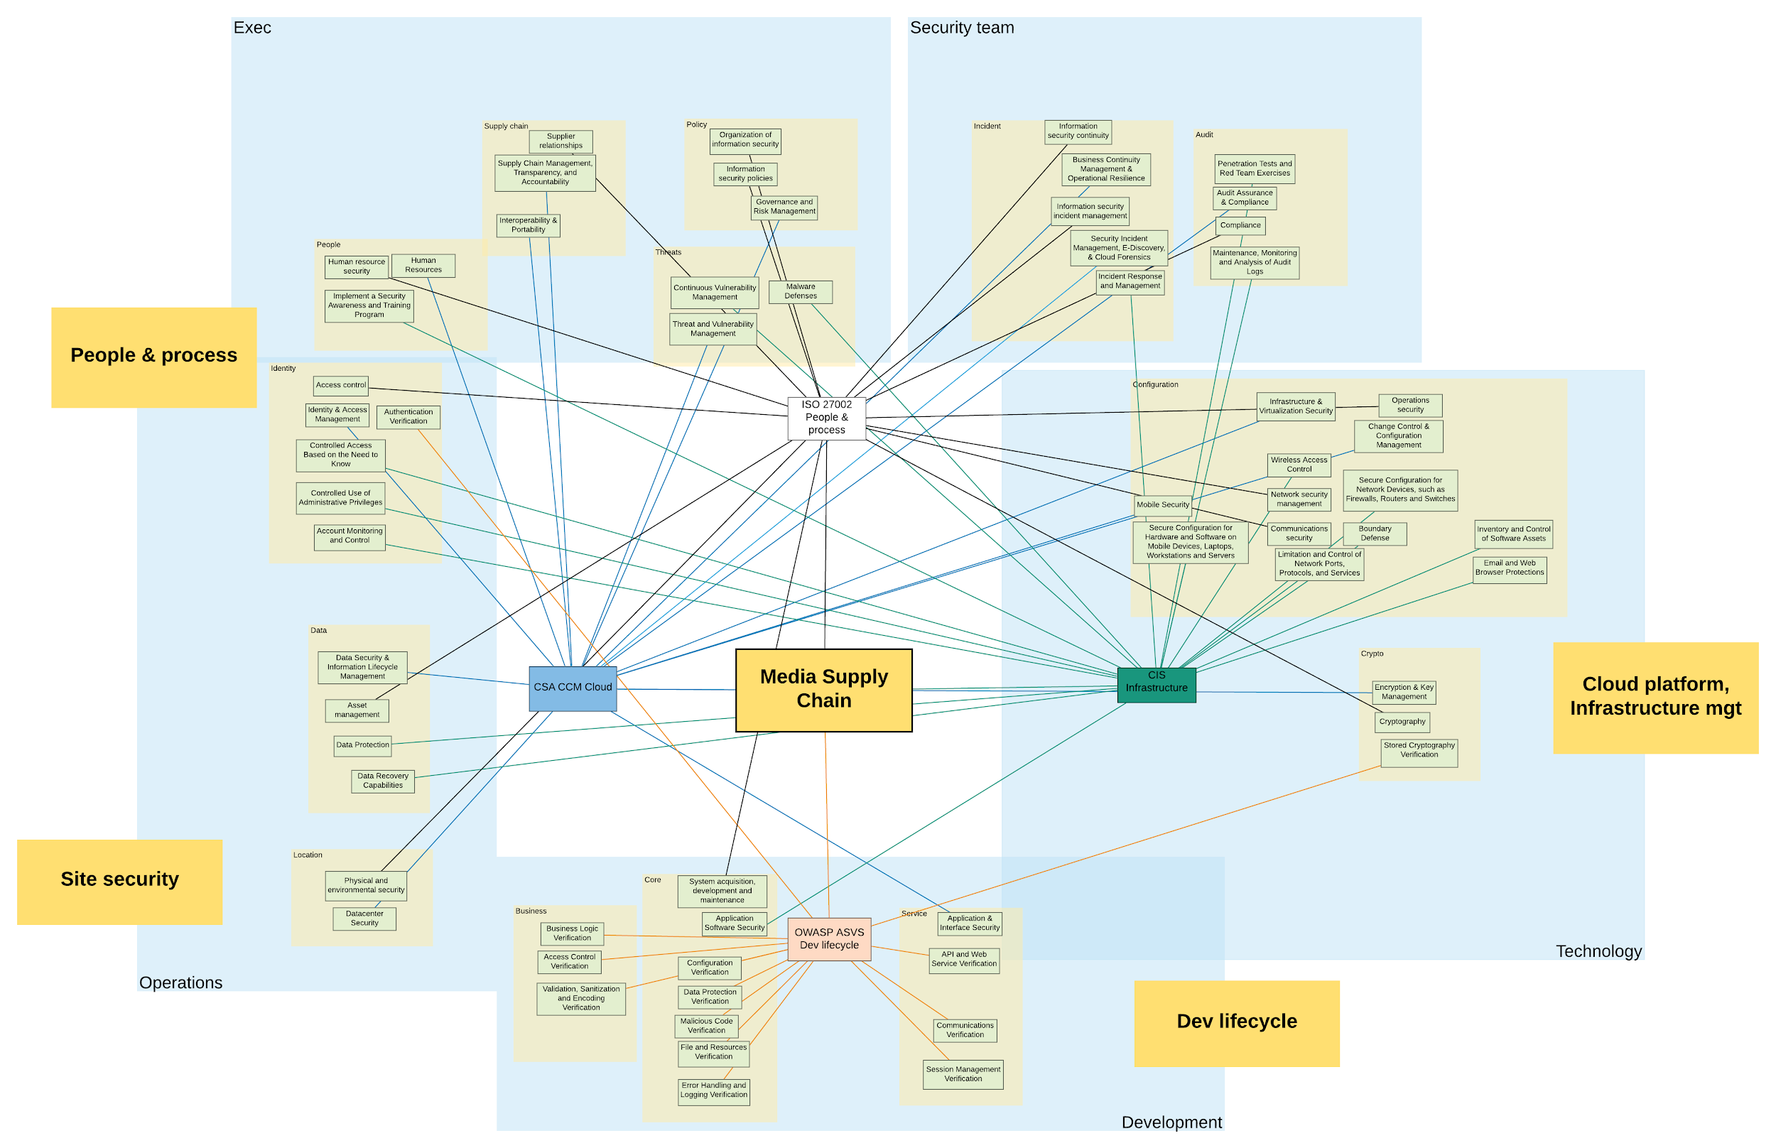
New control framework

Slide 13
4. Updates
Version control
JIRA Confluence
1. Controls
Vendor roster
Shared reports
Status
Audit
booking
Standards
Controls
3. Process
MPA
Site security
Site
Procedures
Vendor
Specific
Operations
Design guide
Reduce controls maintenance effort
Leverage cloud platform collateral
Usable documentation, easy to adopt approach
Highlight control changes and new threats
Enable skills development
Service specific
use case
Site audit
CSA CCM 3.0.1
Cloud
People & process
Meetings
Incidents
Defects
Release pipeline
CIS
Workloads
Cloud platform
Automated remote checks
Service specific
OWASP
ASVS
Infrastructure
management
Risk register
Dev lifecycle
Service specific
Identity
Bounty based continuous test
5. People
Custom
4. Updates
Training
register
Threat model
2. Collateral
Secure config guidelines
AWS
Platform certification
Secure config guidelines
Training
Materials
ME-ISAC
Github Toolbox
Secure config guidelines
Azure
GCP
Other...

Slide 14
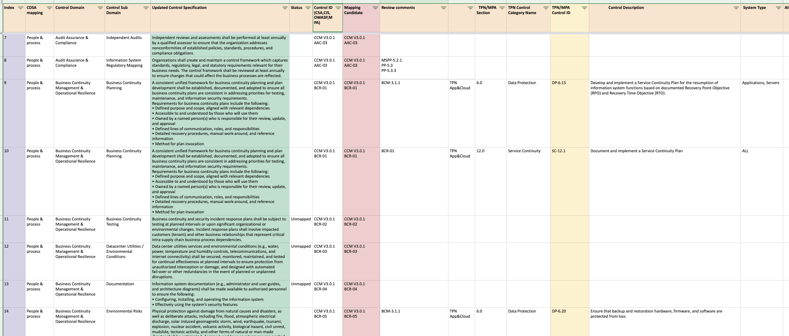
Control set

Slide 15
Conclusion
Improved content security in studio supply chain, including cloud
Common control set, with low maintenance effort
Efficient operations, higher frequency of assurance mapped to current threats
Shared audit reports for studios, with greater detail
Reduced costs for vendors, to establish security culture
Global talent pool for auditors, attract resource from other sectors

